Slide 1
VTL Task Force
VTL Information Model
VTL TF Meeting – Salamanca 20 June 2025

Slide 2
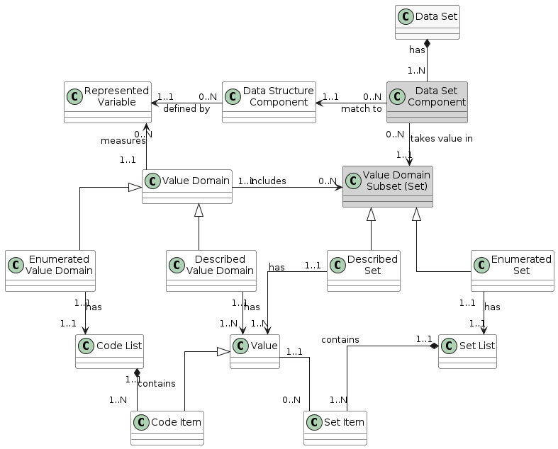
VTL current IM
REPORTED ISSUES
Relationship constraint between Represented Variable and Data Structure Component (1:1)
Not clear the relation of Value Domain with data type
Not clear the role of the entity Represented Variable
VTL TF Meeting – Salamanca 20 June 2025
2

Slide 3
Reported problematic use cases (SDMX)
Difference with SDMX IM
How to deal with data coming from different agencies?
DS1 (agency AG1)
Component | Local Representation
COUNTRY | CL_AREA_SUBSET1
INDICATOR | CL_INDICATOR
TIME_PERIOD | date
OBS_VALUE | number
role
Concept
0..**
Component
0..1
0..1
core
local
0..1
0..1
enumerated
DS2 (agency AG1)
Component | Local Representation
COUNTRY | CL_AREA_SUBSET2
TIME_PERIOD | date
OBS_VALUE | date
Representation
nonEnumerated
enumerated
0..**
0..1
0..1
Facet
CodeList
ValueList
DS3 (agency AG2)
Component | Local Representation
COUNTRY | CL_AREA
INDICATOR | AG2_INDICATORS
TIME_PERIOD | date
OBS_VALUE | number
VTL TF Meeting – Salamanca 20 June 2025
3

Slide 4
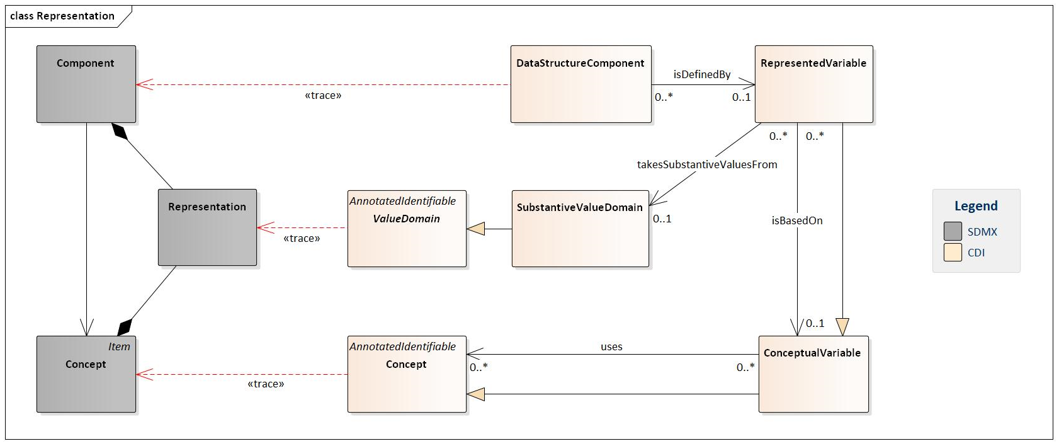
Mapping between SDMX and DDI IM
VTL TF Meeting – Salamanca 20 June 2025
4

Slide 5
DPM Information Model (extract)
VTL TF Meeting – Salamanca 20 June 2025
5

Slide 6
Main takeaways
Dropping Represented Variable entity is not an option: it cannot be eliminated to ensure interoperability
It could be arguable modifying relation cardinality (from 1:1 to 0:1)
In any case use cases with eterogeneous relation between component and referred domain (or data type) requires specific treatment
VTL TF Meeting – Salamanca 20 June 2025
6

Slide 7
Some possible hints to handle presented use cases
Please note that SDMX comes from a «time series approach» with only one measure, while VTL is inherently multi-measure. The change introduced in SDMX 3.0 has been «pushed» to make SDMX able to handle granular data
DS1 (agency AG1)
Component | Local Representation
COUNTRY | CL_AREA_SUBSET1
INDICATOR | CL_INDICATOR
TIME_PERIOD | date
OBS_VALUE | number
JOIN DS1 & DS2 WITH MULTIPLE MEASURES
It is mandatory to rename one (or both) OBS_VALUE component
DS2 (agency AG1)
Component | Local Representation
COUNTRY | CL_AREA_SUBSET2
TIME_PERIOD | date
OBS_VALUE | date
COMPARING DS1 & DS2
It is mandatory to CAST one (or both) OBS_VALUE component with (possibile) renaming
DS3 (agency AG2)
Component | Local Representation
COUNTRY | CL_AREA
INDICATOR | AG2_INDICATORS
TIME_PERIOD | date
OBS_VALUE | number
OTHER TRANSFORMATION ?
VTL TF Meeting – Salamanca 20 June 2025
7

Slide 8

QUESTION TIME
VTL TF Meeting – Frankfurt 25-26 March 2025
8

